Slide 1
WRITTEN COMMUNICATION
Is the art of transmitting messages, thoughts, and ideas through the written word.

Slide 2
Definition of written communication
This is the exchange of information, ideas, thoughts or messages through written word.

Slide 3
TYPES OF WRITTEN COMMUNICATION
Formal written communication: Official documents, reports, proposals, and business letters, formal emails.
Informal written communication: Personal emails, text messages, social media posts, and blogs.
Creative written information: Creative writing introduces a touch of artistry to written communication. Poetry, short stories, and blog posts exemplify this style. Creative writing explores the depths of human imagination, invoking emotions and vivid imagery.
Academic written information: This type of writing includes essays, research papers, and presentations. Academic writing upholds a formal tone, requiring proper citation and adherence to established formats.

Slide 4
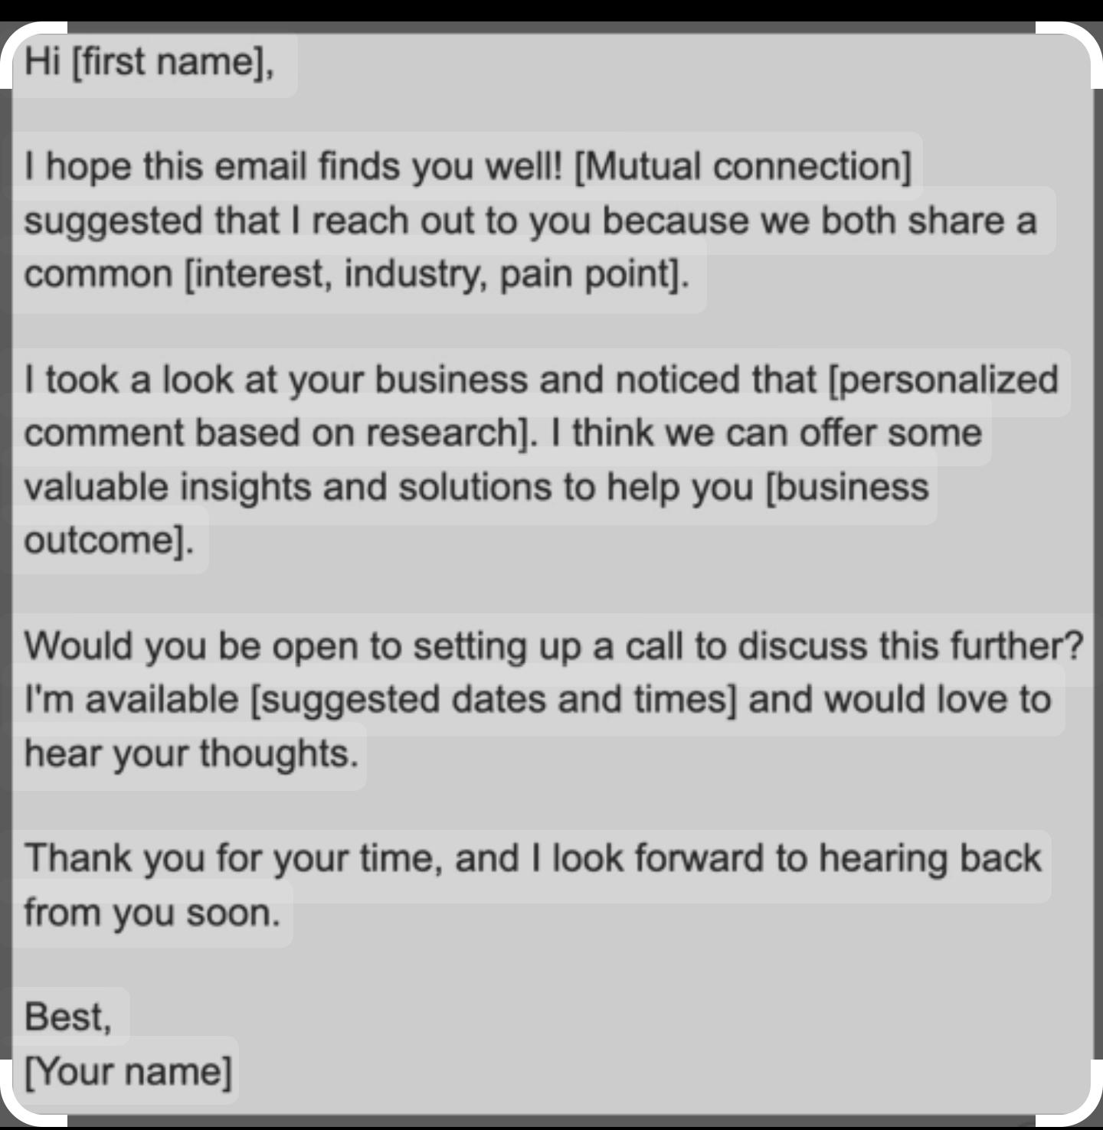
Forms/examples of effective communication.
Formal business emails:
DEMONSTRATION
These messages are structured, concise, and adhere to a specific etiquette. For instance, sending a well-constructed email to a prospective client introducing your company's services demonstrates effective formal communication. The tone should remain respectful and informative, reflecting the sender's professionalism.

Slide 5
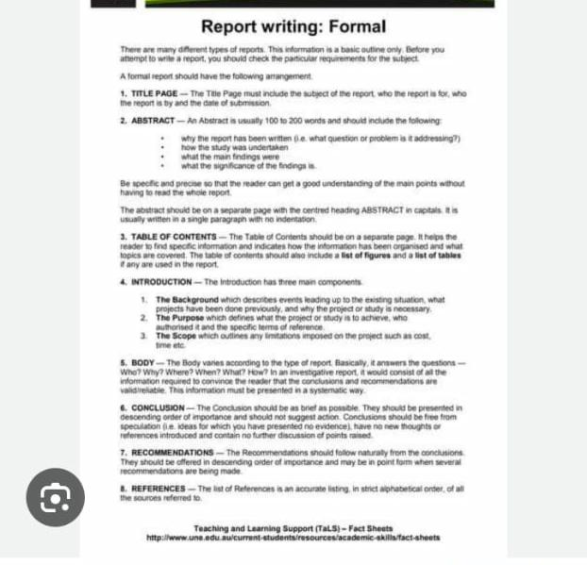
Reports
Is a documented presentation of information, analysis and findings on a specific topic, issue or report.

Slide 6
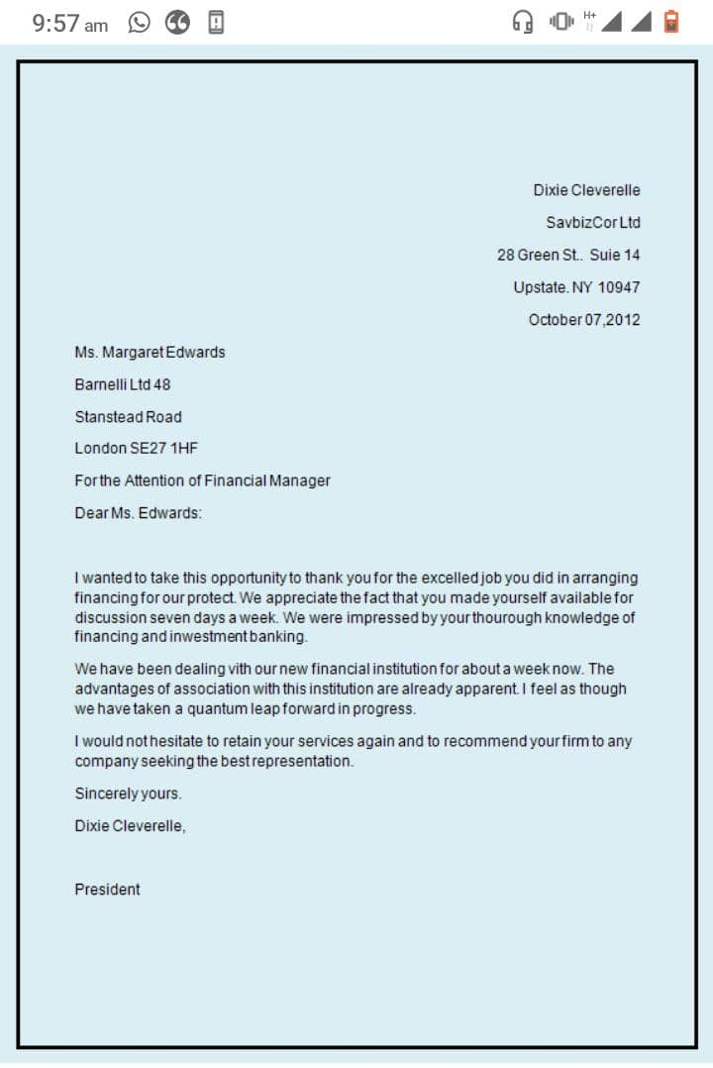
Business letter
This is a letter from one company to another or from an organization to its customers/clients or other external parties.
COMPONENTS OF A BUSINESS LETTER.
Heading
Recipients address
Salutation
Body
Closing
Signature

Slide 7
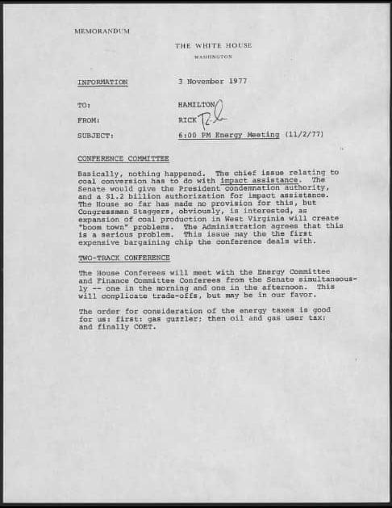
BUSINESS MEMOS
A memorandum(memo) is a written report prepared specifically for a person or group of people that contains information about a particular matter.

Slide 8
PRESS RELEASES
An official statement delivered to members of the new media for the purpose of providing information, creating an official statement or making an announcement directed for public release.
These are considered as the primary sources of information
The components of the press release include:
Headline
Dateline
Introduction
Body
Conclusion
Boilerplate.

Slide 9
BLOGS
A type of online journal or informational website that features informal conversations content.
Types of blogs
Personal blogs
Business blogs
Niche blogs e.g fashion
Educational blogs
News blogs

Slide 10
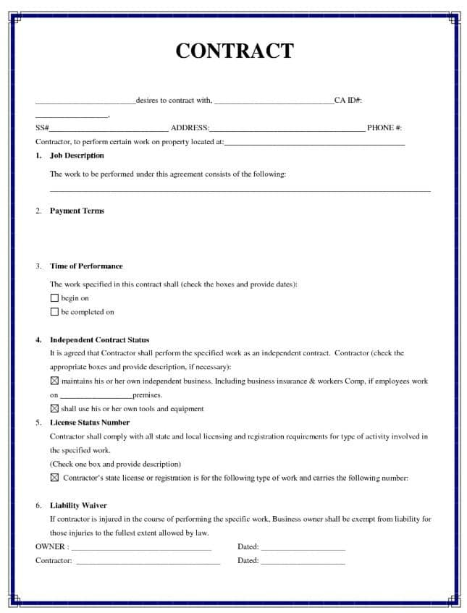
CONTRACTS
DEMONSTRATION
A contract is an agreement between two or more parties creating a mutual commitment that are enforceable by law.
Contracts can be bilateral or unilateral.
Bilateral contracts: Provide services or goods that are of value to the other party.
Unilateral contracts: Provide services or goods that the other party requested, usually in an open request.
Proposals: A proposal is a suggestion on especially a formal or written one put forward for consideration by others.

Slide 11
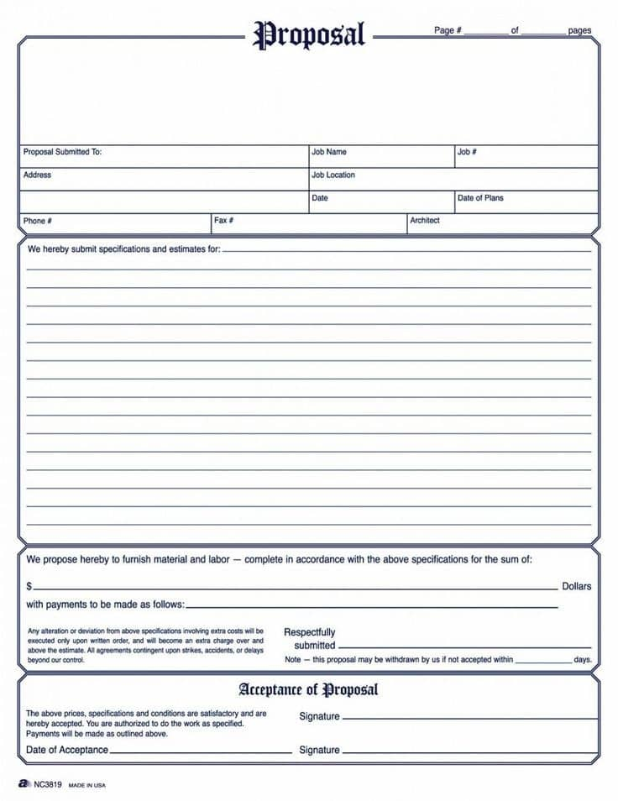
PROPOSALS
A proposal is a suggestion especially a formal or written one put forward for consideration by others.
Qualities or proposals.
A well definition of the problem.
A clearly stated proposal to solve the problem.
An evaluation of the benefits of your proposal.
A careful analysis for your audience.
A reasonable, sensible tone.

Slide 12
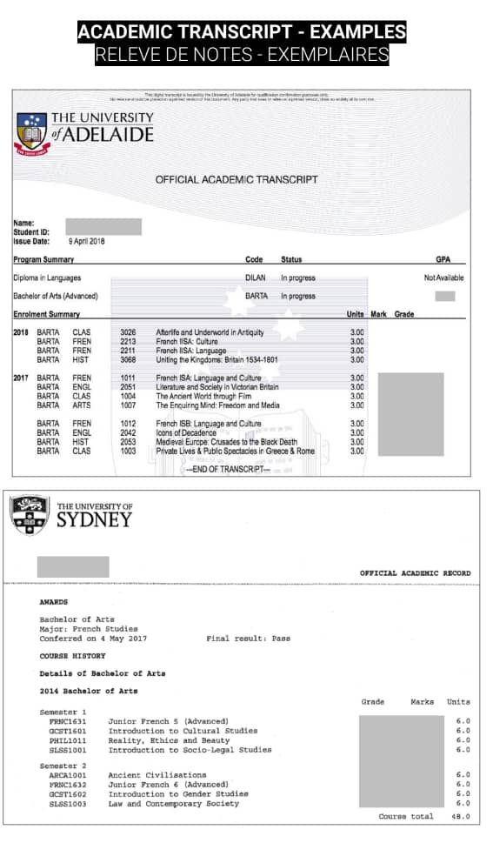
TRANSCRIPTS
A transcript is an official document a student’s academic performance.
Transcripts are essential when transferring credits (for international students) applying for a new degree program or even studying abroad.

Slide 13
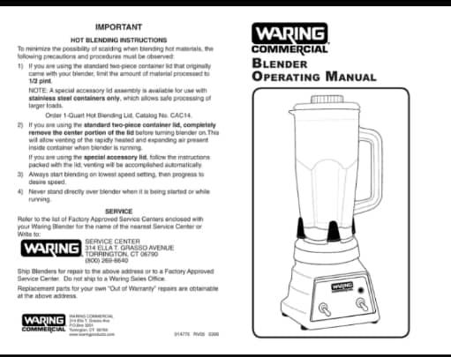
MANUALS
A manual is a crucial piece of documentation that conveys technological, engineering, specific or other technical knowledge to help customers use a product or piece of equipment.
Manuals can be both hard copy or soft copy.

Slide 14
Examples of communication cont’d
Text messages: Text messages are characterized by their casual tone, use of abbreviations, and emojis. The language used is relaxed and often mirrors spoken language, fostering a sense of familiarity and ease.
Social media posts: From Facebook statuses to Twitter updates and Instagram captions, these informal writing opportunities allow you to express yourself freely. The language is personal, engaging, and may include humor or personal anecdotes that boost your personal brand.
Personal letters: Although originally rather formal, personal letters have transitioned into the realm of informality. Letters written to friends or family members often showcase a mix of personal anecdotes, emotions, and everyday language. The language is warm, reflective of personal connections, and might include elements of nostalgia or shared experiences.

Slide 15
Academic writing
Essays: Essays are fundamental forms of academic writing that require students to analyze and present arguments on specific topics. The essay is structured with an introduction, body paragraphs, and a conclusion, all aimed at conveying a well-organized argument supported by evidence.
Research papers: Research papers dive deeper into specific subjects, often requiring extensive investigation and citation of sources. They should be organized with specific sections such as an introduction, literature review, methodology, findings, and conclusion. This type of academic writing focuses on presenting original insights backed by thorough research.
Presentations: While presentations involve spoken communication, their accompanying slides often feature written content. Academic presentations might include a slide deck explaining the findings of a research study. Each slide contains concise written points that support the speaker's verbal explanations. Effective academic presentation writing ensures clarity and conciseness, to aid the audience's understanding.

Slide 16
Creative writing
Poetry: Poetry is an artistic form of written communication that emphasizes rhythm, imagery, and emotions. In such works, words are carefully chosen to evoke feelings and paint vivid mental pictures, allowing readers to experience a heightened emotional connection.
Short stories: Short stories are concise narratives that capture a moment, an emotion, or a complete tale in a limited space. An example of creative writing as a short story could be a suspenseful narrative that unfolds over a few pages, engaging readers with its characters, plot twists, and resolution. Creative short stories often explore themes of human nature and provide a glimpse into unique worlds or experiences.
Novels: Novels stand as an epitome of creative writing, offering a more extensive canvas for storytelling. Novels delve deep into emotions, relationships, and the complexities of human existence, allowing readers to immerse themselves in fictional realms with remarkable depth.

Slide 17
Qualities of an effective written communication.
Clarity: Clarity is arguably the cornerstone of good writing. It ensures your message is understood by eliminating ambiguity, confusion, and misinterpretation. Prioritize simplicity over complexity, using clear and concise sentences to deliver your message effectively. Avoid unnecessary jargon and convoluted phrases, aiming to convey ideas in a straightforward manner.
Understand your audience: It's critical to consider who will be reading what you write. Think about their knowledge, interests, and expectations when crafting your message. Adjust your tone, style, and choice of words to resonate with your intended readers. This ensures that your message is relatable and engaging, enhancing its impact.
Grammar and spelling: If there's one thing that will turn people off your writing, it's improper grammar and bad spelling. Maintaining proper grammar and spelling reflects professionalism and attention to detail. Proofread your work meticulously or use online tools to catch errors.

Slide 18
Qualities cont’d
Purposefulness: Each piece of writing should have a clear purpose, whether to inform, persuade, or entertain.
Engagement: Using a tone and style that captivates the reader helps maintain interest.
Supportiveness: Providing evidence, examples, or data to back up claims strengthens the message.
Empathy: Understanding the reader's perspective and addressing their needs fosters a connection.
Revisability: Good writing often involves revising and editing to enhance clarity and effectiveness

Slide 19
Importance of effective written communication
For clarity and precision: Allows us to be clear and concise in our messages.
Record keeping: Written communication serves as a permanent record for our interactions which can be helpful in legal or business situations.
Professionalism: It shows that we take our interactions seriously and are willing to put in the effort in the effort to communicate effectively.
Accessibility: Written communication can be accessed at any time, anywhere, as long as the recipeint has access to the written document.
Avoids misunderstandings and confusion.
Builds trust and credibility.
Foster relationships.
Saves time and resourses.

